Slide 1

Get In Touch With Us
Himalaya Classification Project
Predicting high altitude mountaineering success rates through machine learning
Felix Grabscheit
Philipp Kron
Master Data Science WS2019.20
Introduction to Data Science

Slide 2
Data Science Problem
Project Summary
Default risk detection:
Decide if a particular customer is likely to die on a mountaineering expedition
Marketers must link the price to the real and perceived value of the product, but they also must take into account supply costs, seasonal discounts, and prices used by competitors. In some cases, business executives.
Data Science Technique
Marketers must link the price to the real and perceived value of the product, but they also must.
Real world application
Marketers must link the price to the real and perceived value of the product, but they also must.

Slide 3
Agenda
Refers to a good or service being offered by a company. Ideally, a product should meet a certain consumer demand, or it should be so compelling that consumers believe they need it.
Start
Marketers must link the price to the real and perceived value of the product, but they also must take into account supply costs.
Expansion
Marketers must link the price to the real and perceived value of the product, but they also must take into account supply costs.

Slide 4
New Location
Marketers must link the price to the real and perceived value of the product, but they also must
New Products
Marketers must link the price to the real and perceived value of the product, but they also must
New Associates
Marketers must link the price to the real and perceived value of the product, but they also must
New Products
Marketers must link the price to the real and perceived value of the product, but they also must take into account supply costs.

Slide 5



Business Opportunity
Title One
Refers to a good or service being offered by a company. Ideally, a product should meet a certain consumer demand, or it should be so compelling that consumers believe they need it. But they also must take into account supply costs.
The goal of business executives is to get their products in front of the consumers who are most likely to buy them.
https://kathmandupost.com/2/2019/12/15/climbing-everest-will-now-require-a-full-medical-history-insurance-and-a-certificate

Slide 6
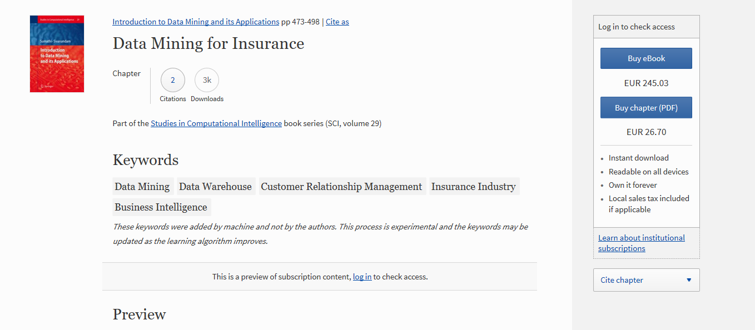
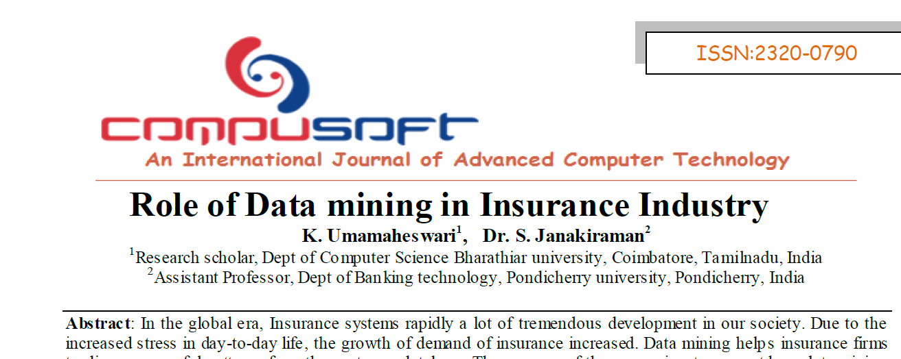

https://www.insurancebusinessmag.com/us/news/breaking-news/insurers-threaten-to-stop-covering-everest-trekkers-123429.aspx

Slide 7
Database
Title One
Refers to a good or service being offered by a company. Ideally, a product should meet a certain consumer demand, or it should be so compelling that consumers believe they need it. But they also must take into account supply costs.
The goal of business executives is to get their products in front of the consumers who are most likely to buy them.

Slide 8



Slide 9
Data Veracity
Marketers must link the price to the real and perceived value of the product.
Title One
Marketers must link the price to the real and perceived value of the product.
Title Two
Marketers must link the price to the real and perceived value of the product.
Title Three
Notes:
What Is Data Veracity?
Data veracity, in general, is how accurate or truthful a data set may be. In the context of big data, however, it takes on a bit more meaning. More specifically, when it comes to the accuracy of big data, it’s not just the quality of the data itself but how trustworthy the data source, type, and processing of it is. Removing things like bias, abnormalities or inconsistencies, duplication, and volatility are just a few aspects that factor into improving the accuracy of big data.
https://www.gutcheckit.com/blog/veracity-big-data-v/

Slide 10
Data Preparation
Climber Experience
Variable Preselection
Age Groups
Insurance Case
Refers to a good or service being offered by a company.
Refers to a good or service being offered by a company.
Refers to a good or service being offered by a company.
Refers to a good or service being offered by a company.

Slide 11
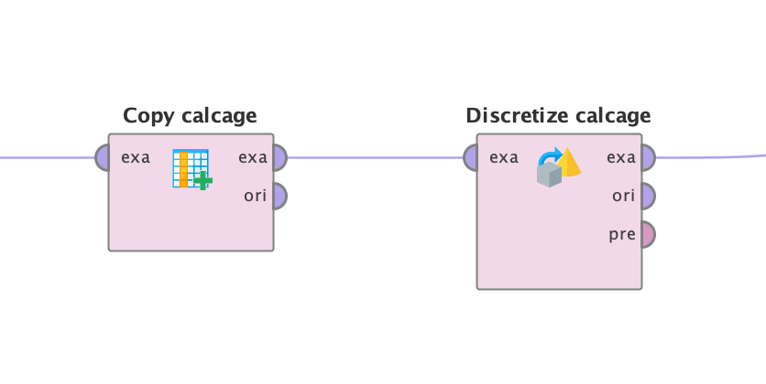
Age Groups
Operator: Discretize by User Specification
Refers to a good or service being offered by a company. Ideally, a product should meet a certain consumer demand, or it should be so compelling that consumers believe they need it.
Climber Experience
Refers to a good or service being offered by a company. Ideally, a product should meet a certain consumer demand, or it should be so compelling that consumers believe they need it.

Slide 12
Insurance Case
Refers to a good or service being offered by a company. Ideally, a product should meet a certain consumer demand, or it should be so compelling that consumers believe they need it.
Title Two
Refers to a good or service being offered by a company. Ideally, a product should meet a certain consumer demand, or it should be so compelling that consumers believe they need it.

Slide 13
About Us
Marketers must link the price to the real and perceived value of the product, but they also must.

Slide 14
A Welcome Wear
Ben Robertson
The type of product also partially dictates how much businesses. In some cases, business executives may manipulate a price to make a product seem more like a luxury.

Slide 15
A Welcome Wear
Ben Robertson
The type of product also partially dictates how much businesses. In some cases, business executives may manipulate a price to make a product seem more like a luxury.

Slide 16
Our Company Values
Element One
Marketers must link the price to the real and perceived value of the product, but they also a certain consumer demand.
Element Two
Marketers must link the price to the real and perceived value of the product, but they also a certain consumer demand.
Element Three
Marketers must link the price to the real and perceived value of the product, but they also a certain consumer demand.
Element Four
Marketers must link the price to the real and perceived value of the product, but they also a certain consumer demand.

Slide 17
Our Company Values
Title One
Title Two
Title Three
Title Four
Title Five
Refers to a good or service being.
Refers to a good or service being.
Refers to a good or service being.
Refers to a good or service being.
Refers to a good or service being.

Slide 18
Our Company Values
Write Your Title Here
Write Your Title Here
Marketers must link the price to the real and perceived value of the product.
Marketers must link the price to the real and perceived value of the product.
Write Your Title Here
Write Your Title Here
Marketers must link the price to the real and perceived value of the product.
Marketers must link the price to the real and perceived value of the product.

Slide 19
Our Company Values
Title One
Title Two
Title Three
Title Four
Place decisions outline where the product is sold and how it is delivered.
Place decisions outline where the product is sold and how it is delivered.
Place decisions outline where the product is sold and how it is delivered.
Place decisions outline where the product is sold and how it is delivered.

Slide 20
Our Company Values
Title One
The type of product.
Marketers must link the price to the real and perceived value of the product, but they also must take into account supply costs, seasonal discounts, and prices used by competitors. In some cases, business executives. Place decisions outline where the product is sold and how it is delivered to the market.
The goal of business executives is to get their products in front of the consumers who are most likely to buy them.
Title Two
Marketers must link.
Title Tree
Account supply costs.
Title Four
Business executives.

Slide 21
Our Company Values
Title One
Title Two
Title Three
Refers to a good or service being offered by a company.
Refers to a good or service being offered by a company.
Refers to a good or service being offered by a company.

Slide 22
Title One
Our Company Values
The type of product.
Marketers must link the price to the real and perceived value of the product, but they also must take into account supply costs, seasonal discounts, and prices used by competitors. In some cases, business executives. Place decisions outline where the product is sold and how it is delivered to the market.
The goal of business executives is to get their products in front of the consumers who are most likely to buy them.
Title Two
Marketers must link.
Title Tree
Account supply costs.
Title Four
Business executives.

Slide 23
Business Philisophy
Title One
Refers to a good or service being offered by a company. Ideally, a product should meet a certain consumer demand, or it should be so compelling that consumers believe they need it. But they also must take into account supply costs.
The goal of business executives is to get their products in front of the consumers who are most likely to buy them.

Slide 24
Business Philisophy
Title One
Refers to a good or service being offered by a company. Ideally, a product should meet a certain consumer demand, or it should be so compelling that consumers believe they need it. But they also must take into account supply costs.
The goal of business executives is to get their products in front of the consumers who are most likely to buy them.

Slide 25
Company’s Timeline
Title Two
Title Four
Marketers must link the price to the real.
Marketers must link the price to the real.
Title One
Title Three
Marketers must link the price to the real.
Marketers must link the price to the real.

Slide 26
“The future belongs to those who believe in the beauty of their dreams”
— Eleanor Roosevelt
Place decisions outline where the product is sold and how it is delivered to the market. The goal of business executives is to get their products in front of the consumers who are most likely to buy them.

Slide 27
Title One
Refers to a good or service being offered by a company. Ideally, a product should meet a certain consumer demand, or it should be so compelling that consumers believe they need it. But they also must take into account supply costs
Title Two
Refers to a good or service being offered by a company. Ideally, a product should meet a certain consumer demand, or it should be so compelling that consumers believe they need it. But they also must take into account supply costs.

Slide 28
Professional Business & Consulting
Title One
Something about us
The type of product also partially dictates how much businesses. In some cases, business executives may manipulate a price to make a product.
Title Two
Something about us

Slide 29
Title One
Refers to a good or service being offered by a company. Ideally, a product should meet a certain consumer demand, or it should be so compelling that consumers believe they need it. But they also must take into account supply costs
Title Two
Refers to a good or service being offered by a company. Ideally, a product should meet a certain consumer demand, or it should be so compelling that consumers believe they need it. But they also must take into account supply costs.

Slide 30
Professional Business & Consulting
Title One
Something about us
The type of product also partially dictates how much businesses. In some cases, business executives may manipulate a price to make a product.
Title Two
Something about us

Slide 31
Title One
Title Two
Marketers must link the price to the real and perceived value of the product, but they also must take into account supply costs.
Marketers must link the price to the real and perceived value of the product, but they also must take into account supply costs.

Slide 32
Title One
Title Two
Marketers must link the price to the real and perceived value of the product, but they also must take into account supply costs.
Marketers must link the price to the real and perceived value of the product, but they also must take into account supply costs.

Slide 33
Our Mission
“Successful people keep moving. They make mistakes, but they don’t quit.”
Refers to a good or service being offered by a company. Ideally, a product should meet a certain consumer demand, or it should be so compelling that consumers believe they need it.

Slide 34
Meet Our Team
Halie Meagan
John Smith
Katy Mills
Ryan McGill
Marketers must link the price to the real
Marketers must link the price to the real
Marketers must link the price to the real
Marketers must link the price to the real

Slide 35
Meet Our Team
Madison Bruke
The type of product also partially dictates how much businesses. In some cases, business executives may manipulate a price to make a product seem more like a luxury.

Slide 36
Meet Our Team
Amanda Smith
David Nicholson
Marketers must link the price to the real and perceived value.
Marketers must link the price to the real and perceived value.
Madison Bruke
Katy Mills
Marketers must link the price to the real and perceived value.
Marketers must link the price to the real and perceived value.

Slide 37
Meet Our Team
Halie Meagan
Bryan McGill
Ben Anderson
Madison Bruke
Refers to a good or service being offered by a company.
Refers to a good or service being offered by a company.
Refers to a good or service being offered by a company.
Refers to a good or service being offered by a company.

Slide 38
Meet Our Team
Katy Mills
Ryan McGill
Paola Randal's
Service being offered by a company. Ideally, a product should meet a certain.
Service being offered by a company. Ideally, a product should meet a certain.
Service being offered by a company. Ideally, a product should meet a certain.

Slide 39
Meet Our Team
Halie Meagan
Bryan McGill
Ben Anderson
Madison Bruke
Refers to a good or service being offered by a company.
Refers to a good or service being offered by a company.
Refers to a good or service being offered by a company.
Refers to a good or service being offered by a company.

Slide 40
Title One
Refers to a good or service being offered by a company. Ideally, a product should meet a certain consumer demand, or it should be so compelling that consumers believe they need it.
Title Two
Refers to a good or service being offered by a company. Ideally, a product should meet a certain consumer demand, or it should be so compelling that consumers believe they need it.

Slide 41
Title One
Refers to a good or service being offered by a company. Ideally, a product should meet a certain consumer demand, or it should be so compelling that consumers believe they need it.
Title Two
Refers to a good or service being offered by a company. Ideally, a product should meet a certain consumer demand, or it should be so compelling that consumers believe they need it.

Slide 42
Subscribing Plans
Title One
Title Two
$39
Marketers must link the price to the real and perceived value.
$49
Marketers must link the price to the real and perceived value.
Title Three
Title Four
$79
Marketers must link the price to the real and perceived value.
$99
Marketers must link the price to the real and perceived value.

Slide 43
Subscribing Plan
$3240
$435
Place decisions outline where the product is sold and how it is delivered.
Place decisions outline where the product is sold and how it is delivered.
Marketers must link the price to the real and perceived value of the product, but they also must take into account supply costs, seasonal discounts, and prices used by competitors. In some cases, business executives. Place decisions outline where the product is sold and how it is delivered to the market.
The goal of business executives is to get their products in front of the consumers who are most likely to buy them.
$273
$1270
Place decisions outline where the product is sold and how it is delivered.
Place decisions outline where the product is sold and how it is delivered.

Slide 44
Subscribing Plans
$199
The goal of business executives is
$239
Place decisions outline where
$329
Place decisions outline where
$439
The goal of business executives is

Slide 45
Subscribing Plans
$39
$49
$79
$99
Refers to a good or service being offered by a company.
Refers to a good or service being offered by a company.
Refers to a good or service being offered by a company.
Refers to a good or service being offered by a company.

Slide 46
Revenue Model
Marketers must link the price to the real and perceived value of the product, but they also must take into account supply costs, seasonal discounts, and prices used by competitors. In some cases, business executives. To be successful, marketers should understand the life cycle of a product, and business executives should have a plan for dealing with products at every stage of their life cycles.
Title One
Title Two
Title Two
Title Two
47%
24%
24%
24%
Refers to a good or service.
Refers to a good or service.
Refers to a good or service.
Refers to a good or service.

Slide 47
Revenue Model
+120
+70
Refers to a good or service being offered by a company. Ideally, a product should meet a certain consumer demand, or it should be so compelling that consumers believe they need it.
Refers to a good or service being offered by a company.
Refers to a good or service being offered by a company.

Slide 48
Title One
Title Two
Title Two
Title Two
47%
24%
24%
24%
Refers to a good or service.
Refers to a good or service.
Refers to a good or service.
Refers to a good or service.
Revenue Model
Marketers must link the price to the real and perceived value of the product, but they also must take into account supply costs, seasonal discounts, and prices used by competitors. In some cases, business executives. To be successful, marketers should understand the life cycle of a product, and business executives should have a plan for dealing with products at every stage of their life cycles.

Slide 49
Revenue Model
Title One
Title Two
+250
+743
Refers to a good or service.
Refers to a good or service.

Slide 50
Market Validation
+4128
Product should meet a certain consumer demand, or it should be so compelling that consumers believe they need it.
+7390
Product should meet a certain consumer demand, or it should be so compelling that consumers believe they need it.
TITLE A
TITLE B
TITLE C
TITLE D

Slide 51
Market Validation
Marketers must link the price to the real and perceived value of the product, but they also must take into account supply costs, seasonal discounts, and prices used by competitors. In some cases, business executives. To be successful, marketers should understand the life cycle of a product, and business executives should have a plan for dealing with products at every stage of their life cycles. Business executives should have a plan for dealing with products at every stage of their life cycles..
Project One
Project Two
47%
24%
Refers to a good or service.
Refers to a good or service.

Slide 52
Market Validation
+34
+10
+207
+45
Title One
Title Two
Title Three
Title Four
Refers to a good or service being offered by a company.
Refers to a good or service being offered by a company.
Refers to a good or service being offered by a company.
Refers to a good or service being offered by a company.

Slide 53
Market Validation
Marketers must link the price to the real and perceived value of the product, but they also must take into account supply costs, seasonal discounts, and prices used by competitors. In some cases, business executives. To be successful, marketers should understand the life cycle of a product, and business executives should have a plan for dealing with products at every stage of their life cycles. Business executives should have a plan for dealing with products at every stage of their life cycles..
Project One
Project Two
47%
24%
Refers to a good or service.
Refers to a good or service.

Slide 54

Phone
Preview Sample
Title One
Marketers must link the price to the real.
Title Two
Marketers must link the price to the real.

Slide 55
Phone Preview Sample
Title One
Title Two
Marketers must link the price to the real.
Marketers must link the price to the real.

Slide 56
Tablet Preview Sample
Title One
Title Three
Marketers must link the price to the real.
Marketers must link the price to the real.
Title Two
Title Four
Marketers must link the price to the real.
Marketers must link the price to the real.

Slide 57
Phone Preview Sample
Title One
Title Two
Marketers must link the price to the real.
Marketers must link the price to the real.
Marketers must link the price to the real and perceived value of the product, but they also must take into account supply costs, seasonal discounts, and prices used by competitors. In some cases, business executives.

Slide 58

Laptop Preview Sample

Slide 59
Laptop Preview Sample
Your Title
Marketers must link the price to the real and perceived value of the product, but they also must take into account supply costs, seasonal discounts, and prices used by competitors.

Slide 60
Diagram Section
A
B
C
D
Refers to a good or service being offered by a company.
Refers to a good or service being offered by a company.
Refers to a good or service being offered by a company.
Refers to a good or service being offered by a company.

Slide 61
Diagram Section
Mission
Vision
Goals
Values
Strategy
Alive or dead a fish is technically fast
Alive or dead a fish is technically fast
Alive or dead a fish is technically fast
Alive or dead a fish is technically fast
Alive or dead a fish is technically fast

Slide 62
Diagram Section
Your Title
Your Title
Service being offered by a company, ideally, a product.
Service being offered by a company, ideally, a product.
Your Title
Your Title
Service being offered by a company, ideally, a product.
Service being offered by a company, ideally, a product.

Slide 63
Diagram Section
Marketers must link the price to the real and perceived value of the product.
Title One
Marketers must link the price to the real and perceived value of the product.
Title Two
Marketers must link the price to the real and perceived value of the product.
Title Three

Slide 64
Diagram Section
Your Title
Your Title
Marketers must link the price to the real and perceived value.
A
C
Marketers must link the price to the real and perceived value.
Your Title
Your Title
Marketers must link the price to the real and perceived value.
B
D
Marketers must link the price to the real and perceived value.

Slide 65
Diagram Section
A
Write Your Title Here
Refers to a good or service being offered by a company.
B
Write Your Title Here
Refers to a good or service being offered by a company.
C
Write Your Title Here
Refers to a good or service being offered by a company.
Write Your Title Here
D
Refers to a good or service being offered by a company.

Slide 66
Diagram Section
Your Title
Your Title
Your Title
Your Title
Marketers must link the price to the real and perceived value.
Marketers must link the price to the real and perceived value.
Marketers must link the price to the real and perceived value.
Marketers must link the price to the real and perceived value.

Slide 67
Graphic Charts
Title One
Title One
70%
Refers to a good or service being offered by a company.
Title Two
50%
Title Two
Refers to a good or service being offered by a company.
Title Three
90%
Title Three
Refers to a good or service being offered by a company.

Slide 68
Graphic Charts
15%
75%
40%
60%
Title One
Title Two
Title Three
Title Four
Refers to a good or service being offered by a company.
Refers to a good or service being offered by a company.
Refers to a good or service being offered by a company.
Refers to a good or service being offered by a company.

Slide 69
Graphic Charts
60
50
40
30
20
10
0
Title 01
Title 02
Title 03
Title 04
Title 05
Title 06
Title 07

Slide 70
Graphic Charts
90%
85%
65%
50%
40%
Title One
Title Two
Title Three
Title Four
Title Five
A telegraph wire, or a strand of cobweb.
A telegraph wire, or a strand of cobweb.
A telegraph wire, or a strand of cobweb.
A telegraph wire, or a strand of cobweb.
A telegraph wire, or a strand of cobweb.

Slide 71
Graphic Charts
Your Title
Service being offered by a company, ideally a product.
Your Title
Service being offered by a company, ideally a product.
Your Title
Refers to a good or service being offered by a company
Service being offered by a company, ideally a product.
70%
Your Title
Service being offered by a company, ideally a product.
Your Title
Service being offered by a company, ideally a product.

Slide 72
United Estates Editable Map
Title One
Title Two
+98
+480
Refers to a good or service.
Refers to a good or service.

Slide 73
Canada Editable Map
Title One
Title Two
+249
+34
Refers to a good or service.
Refers to a good or service.

Slide 74
Malaysia Editable Map
Title One
Title Two
+614
+70
Refers to a good or service.
Refers to a good or service.

Slide 75
Australia Editable Map
Title One
Title Two
+249
+34
Refers to a good or service.
Refers to a good or service.

Slide 76
China Editable Map
Title One
Title Two
+614
+70
Refers to a good or service.
Refers to a good or service.

Slide 77
Germany Editable Map
Title One
Title Two
+249
+34
Refers to a good or service.
Refers to a good or service.

Slide 79
Get In Touch With Us
Empire State Building
350 5th Ave, New York, NY 10118
(212) 736-3100
Send us a message or visit us. Whenever you like. Refers to a good our service.

Slide 80
thanks

